Slide 1
Know before they go:
Parent pre-departure orientation
Session Leaders:
NTC Office of Study Abroad

Slide 2
TOPIC OUTLINE
Welcome, Topic Outline, Introduction of Panelists
External Application
Tulane’s Two Study Abroad Offices
Tuition and Billing
Academics
Health and Safety Abroad
Travel Logistics
Life Abroad
Questions and OSA contact information
Notes:
Penny

Slide 3
PANELISTS
Ilana Aaquil, Academic Advisor, Study Abroad, Center for Global Education
Siena Farrar, Senior Academic Advisor, Study Abroad, Center for Global Education
Annie Gibson, Administrative Associate Professor and Director of the
Office of Study Abroad, Center for Global Education
John Whisenant, Academic Advisor, Study Abroad, Center for Global Education
MODERATOR
Penny Wyatt, Director of Family Programs
Notes:
Penny

Slide 4
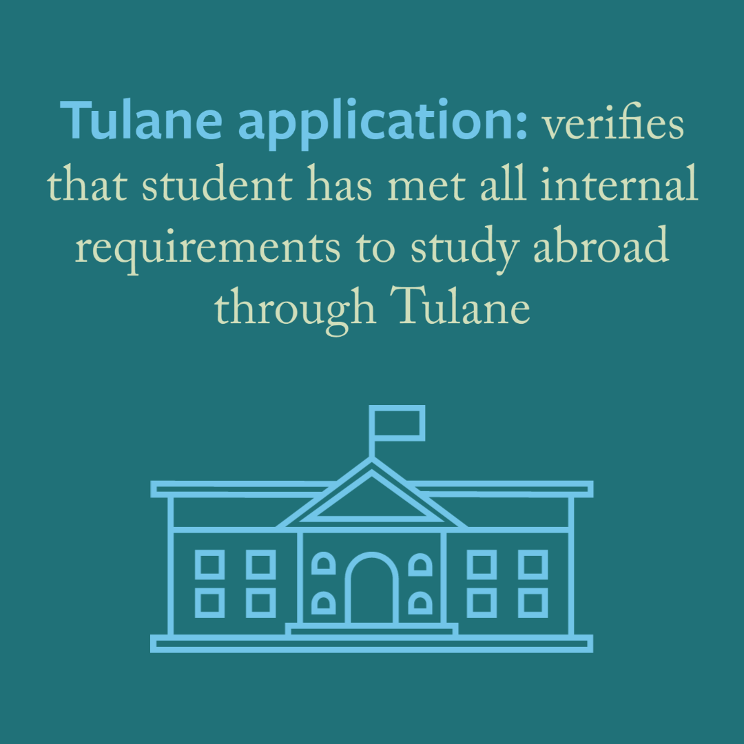
External Application
What is an External Application?
Notes:
1 minute

Slide 5
Two Offices
Office of Study Abroad (OSA)
All Majors
One goal
Freeman Abroad
Business Majors Only
Business majors who want to complete non-business requirements

Slide 6
Tuition and billing
NTC Office of Study Abroad

Slide 7
Home School Tuition Model
While abroad on a Tulane-approved program, students continue to pay Tulane tuition and fees and the Academic Support Fee at the full-time student rate.
Housing, meals, and insurance are typically paid directly by the student to the provider or independently depending on the program.

Slide 8
How Does Billing Work?
Tuition:
All approved students will be automatically registered by our office in a 12-credit hour placeholder course.
Billing through Accounts Receivable and disbursement of scholarships and financial aid occur based on this placeholder course.
Students are not responsible for paying tuition cost to their provider or host university, Tulane pays the program on your behalf, you pay tuition through Accounts Receivable.
Housing:
Student pays cost of housing and insurance to the program directly in most cases.
Students can still use financial aid to cover housing costs abroad—speak to your Financial Aid Advisor
A few programs (EDUCO Paris, REUNIDAS Madrid, BCSP) will have certain housing/insurance costs billed via Tulane.
Independent housing UNLIKELY

Slide 9
Why do we use this model?
Allows federal aid to still apply; students with scholarships still retain their scholarships
Ensures students obtain General Elective Credit for all courses they take
Health, Safety, and Security
Gives students access to on-campus support:
Our office
Success Coaching
Tutoring
Academic Advising
And More

Slide 10
academics
NTC Office of Study Abroad
Notes:
To change the background photo go to: View > Slide Master and edit the Title Slide

Slide 11
Course Transfer
Courses transfer automatically as general electives. Major, minor, or core credit can be awarded through their department
Grades from abroad will appear as letter grades on their transcript but will not be factored into their GPA
Students should meet with their advisors during the application process to discuss prospective courses.
Freeman students can participate on OSA programs, but they usually cannot earn Freeman credit. Some Freeman students choose to participate in OSA programs to earn NTC Core or general credit.

Slide 12
While Abroad
Courses may not be finalized until on site
Remind students to keep all syllabi and coursework
Students must maintain full-time Tulane enrollment – 12 US Credit Hours
Pass/Fail policy – students must alert OSA within 10 weeks of program start date if they want to S/U a course
Classroom expectations and norms can vary – there may be fewer assignments (only midterm/final), more lecture-heavy, stricter attendance policy, less grade inflation

Slide 13
Health and safety Abroad
NTC Office of Study Abroad
Notes:
To change the background photo go to: View > Slide Master and edit the Title Slide

Slide 14
Health Abroad
Begin researching on-site support available to students
Research local conditions that may impact health
Encourage your student to report any and all Goldman Center accommodations to us and their program ASAP. Even if they don’t end up using it – it is better to have it requested early
Plan a method to stay in touch with healthcare providers – therapists, PCPs, specialists, etc.
Research medication laws for host country
Not all medications are legal to import to all countries
Students should plan to bring a FULL supply for their whole program

Slide 15
Insurance
Students are required to demonstrate both domestic and international insurance while abroad.
Three options for coverage:
GeoBluee Tulane school code CME-484
Program insurance
Intl options through domestic provider
Complete annual health insurance waiver.

Slide 16
COVID-19
Tulane students are required to adhere to all local and program policies regarding COVID-19 regardless of vaccination status.
We recommend that all students get their most up-to-date booster dose if eligible prior to going abroad.
Some program locations are more tenuous than others due to case numbers and border restrictions. In most cases, program modifications are more likely than outright cancellation.
What are my expectations for a semester abroad and will a modified program structure meet them?
Program changes could include hybrid/online coursework, mask policies, limitations on independent travel, limitations on independent housing and guest policies, curfews, testing, and restrictions on opening of businesses, etc.

Slide 17
Safety and Security
Before they go:
Our office automatically enrolls students with Crisis24
Travel.state.gov for information about their destination
Enroll in STEP: Smart Traveler Enrollment Program
through the US Department of State

Slide 18
Travel Logistics
NTC Office of Study Abroad
Notes:
To change the background photo go to: View > Slide Master and edit the Title Slide

Slide 19
Passports and visas
Passport: their passport must be valid for at least six months after their study abroad program ends
If they do not have a passport or need to renew do so NOW and pay for expedited service
Visa: applying for a visa is their responsibility
Visa requirements vary by host country, citizenship, and consulate location
Visit consulate website for information, provider may offer some guidance
We are not able to consult on student visa requirements, nor do we have any sway with immigration or consulates
May require your bank statements (potentially notarized)
Summer/winter travel may conflict with visa appointment

Slide 20
Booking travel
Tulane students are required to book through Tulane’s travel provider, World Travel Services, in order to have Tulane support in the case of needed evacuation or ticket changes due to COVID-19 or other on-site emergencies. Students can find information on booking through World Travel on our website and in their acceptance letter.
Try to reduce or eliminate layovers outside the U.S. as this could complicate entry, testing, or quarantine requirements.
Blocks non-refundable fares and budget airlines on portal

Slide 21
Life abroad
NTC Office of Study Abroad
Notes:
To change the background photo go to: View > Slide Master and edit the Title Slide

Slide 22
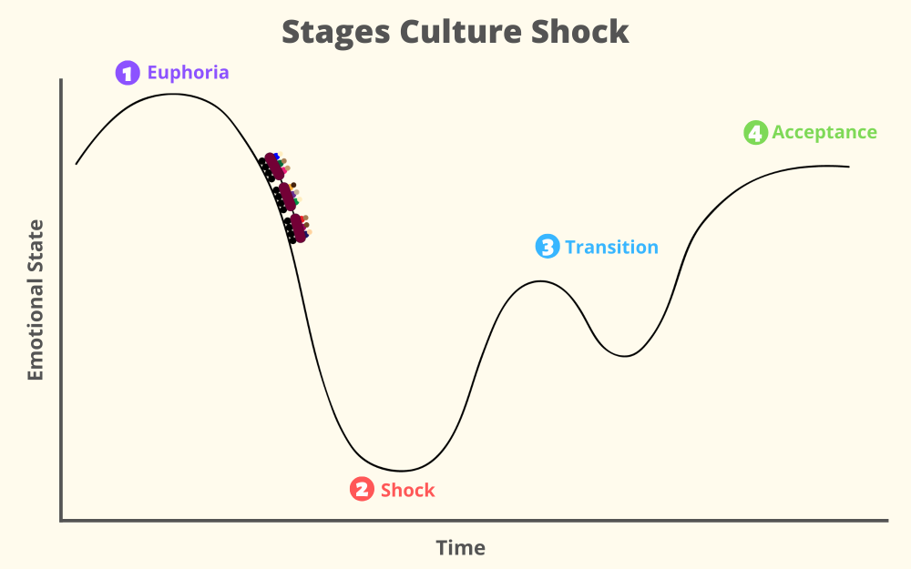
Culture Shock
Your student is likely to go through this, no matter how different or similar their host country is
As advisors, the “shock” stage is also where we get the most amount of calls – you will too!
Encourage a Growth Mindset through “Yet” language. This can frame a negative into a positive.
“I don’t know what the professor is saying in class and I can’t keep up.” -> “I hear you and that’s frustrating. But as you keep going to class, you’ll get more and more practice and it’ll be easier. You just haven’t gotten there yet.”

Slide 23
Housing abroad
Students should understand that housing abroad may not be parallel to housing in New Orleans.
Students studying in major cities should anticipate a commute of at least 30 minutes. 40+ minutes is considered a normal commute in many major cities abroad.
Try not to compare housing—unless they are in a dorm, their classmate's homestay or apartment might not be identical. No living situation is perfect; people are more likely to post/share the positives than the negatives.
Problem with their housing? They should reach out to their program provider first. Try not to make any big decisions within the first few weeks of the program when they’re already adjusting.
Independent housing is nearly always not allowed.

Slide 24
Life Abroad
Talking Abroad
Your student should consider purchasing a local SIM card for their unlocked phone. This is often cheaper than international plans available through domestic providers.
Wifi-based calls can often be less expensive – we recommend WhatsApp or FaceTime Audio
Peer Advisor Suggestion: A shared virtual photo album, where your student can upload photos to send to you when they can’t talk
Money Abroad
Students should research the money culture of their host country before going – cash or credit?
Help them set a budget that includes souvenirs, travel, toiletries, etc.
Food Abroad
If a student lives in a homestay, 2-3 daily meals will be provided.
Students should research whether they can cook for themselves or if they will eat out
If your student has a specific diet, they should research their host country in advance to see if it’s easy to continue while abroad

Slide 25
Life Abroad
Labor Action
Some countries have very strong labor rights and strikes may occur. This can impact classes if the university goes on strike.
Do not encourage your student to attend any demonstrations.
Contacting On Site Staff
You should empower your student to be the first one to reach out to on-site staff. The staff know the students AND are in the same time zone
Due to local laws, some staff may not be able to talk to you.
Other
Encourage your student not to overpack! This is one of the top things students regret doing
With around 50% of Tulane students going abroad, there are likely to be familiar faces either on program or in town
Service/emotional support animals – Your student should speak to OSA and their host program and university ASAP. Some animals may need additional vaccinations; some countries may not be able to accommodate
Encourage your student to get off social media as much as possible – comparison is the thief of joy.
Visiting them – have fun!

Slide 26
Questions?
osa@tulane.edu

